Slide 1
Computer Graphics: Rendering
Autumn 2023
Lecture 1: Introduction and Course Organisation
Kartic Subr

Slide 2









Me: A brief history

Slide 3

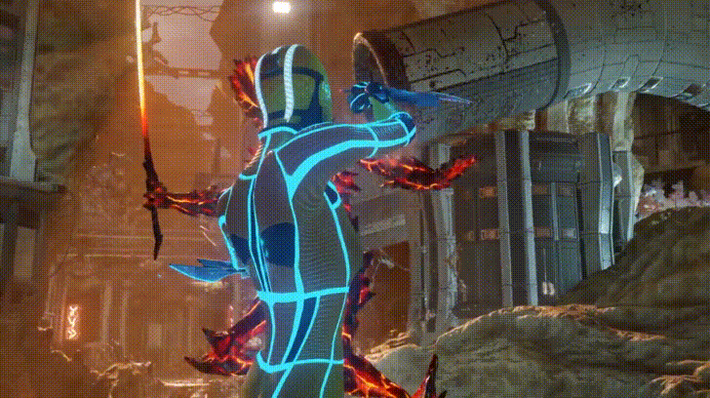
Special Effects
Important Looking Pirates VFX
Video Games
(real-time)
Google Stadia tech demo 2019

Slide 4




Notes:
A common goal is to develop models and simulation mechanisms that mimic reality as closely as possible. But how is this ‘closely as possible’ defined?

Slide 5
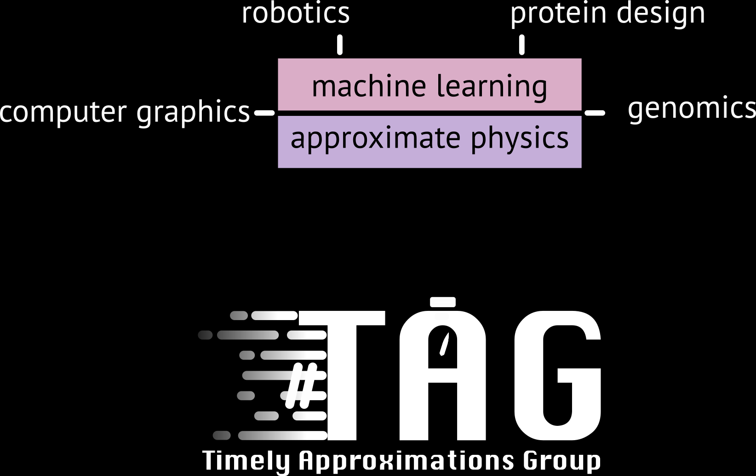

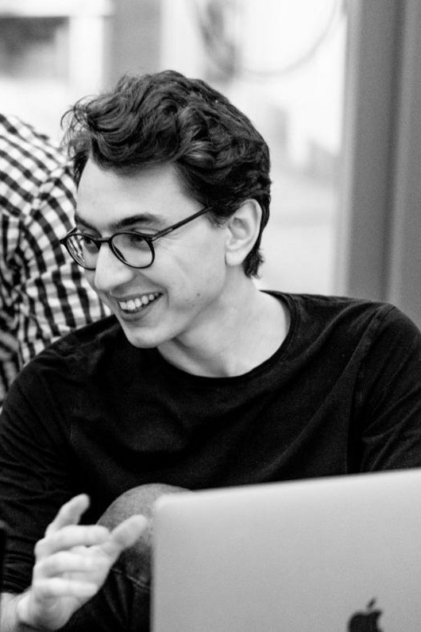
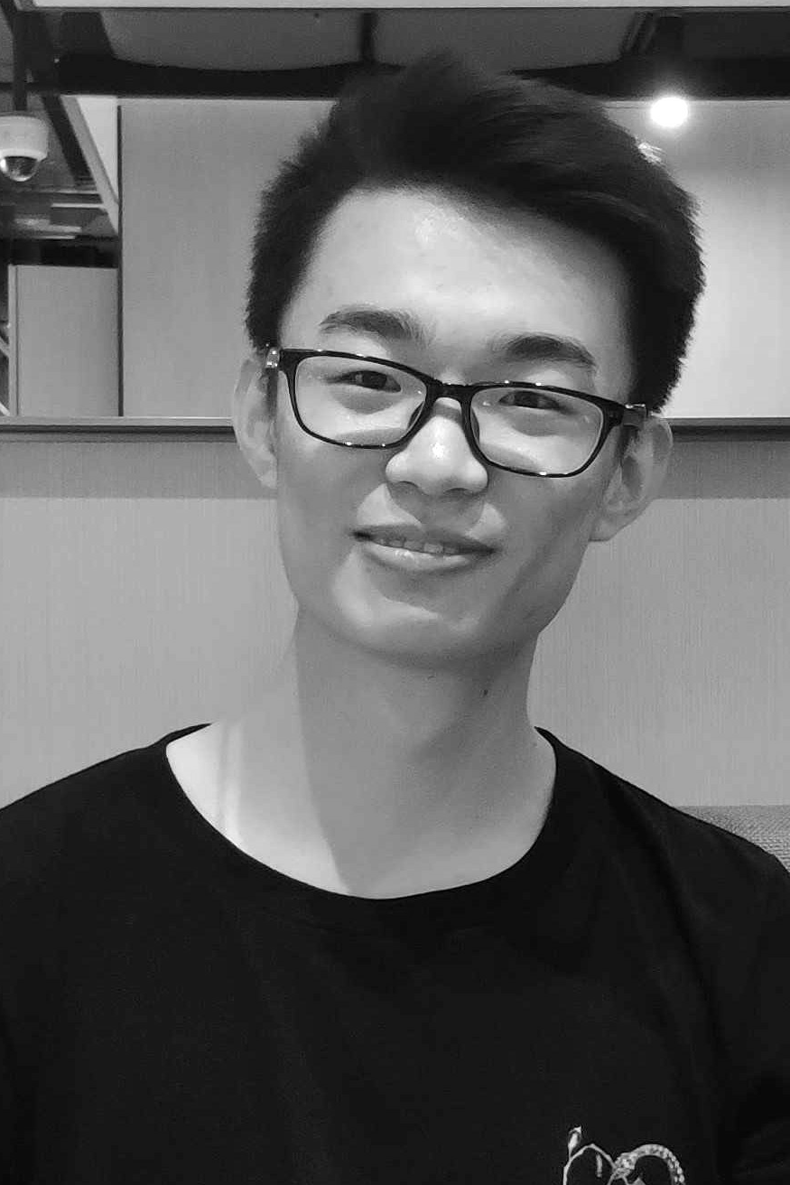


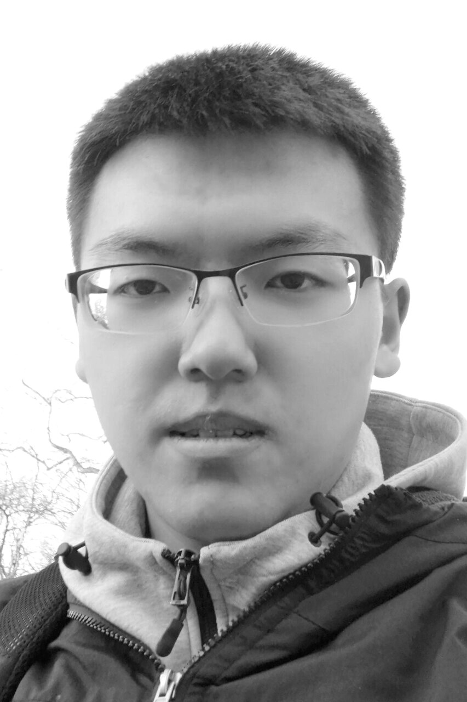


Slide 7
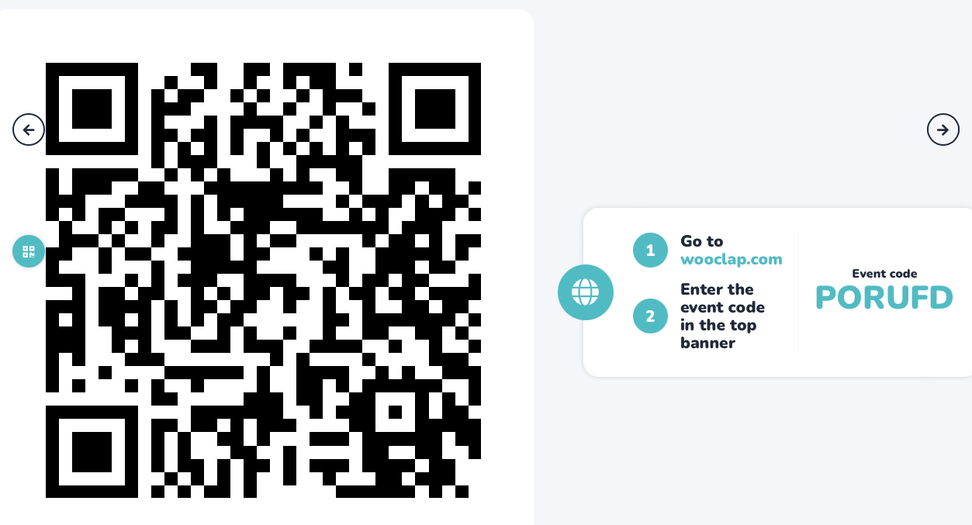
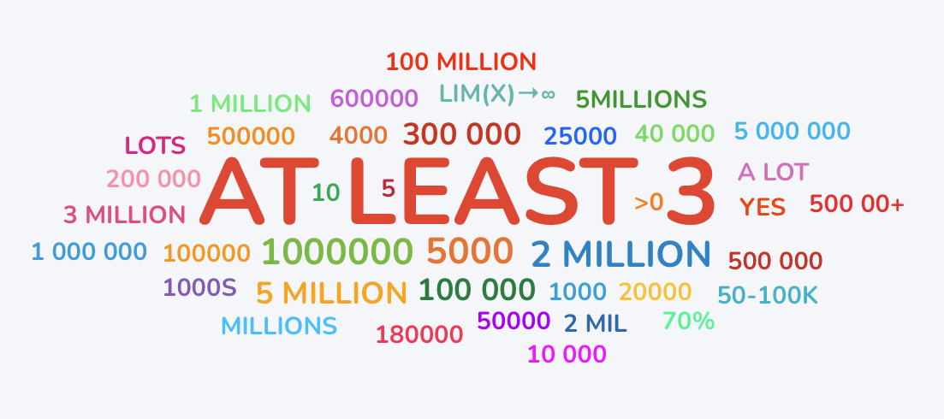
Notes:
A common goal is to develop models and simulation mechanisms that mimic reality as closely as possible. But how is this ‘closely as possible’ defined?

Slide 8
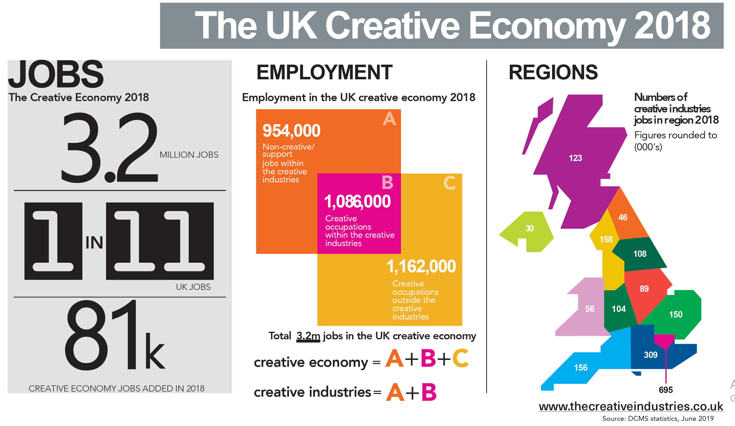
CG is central to the creative industries

Slide 9
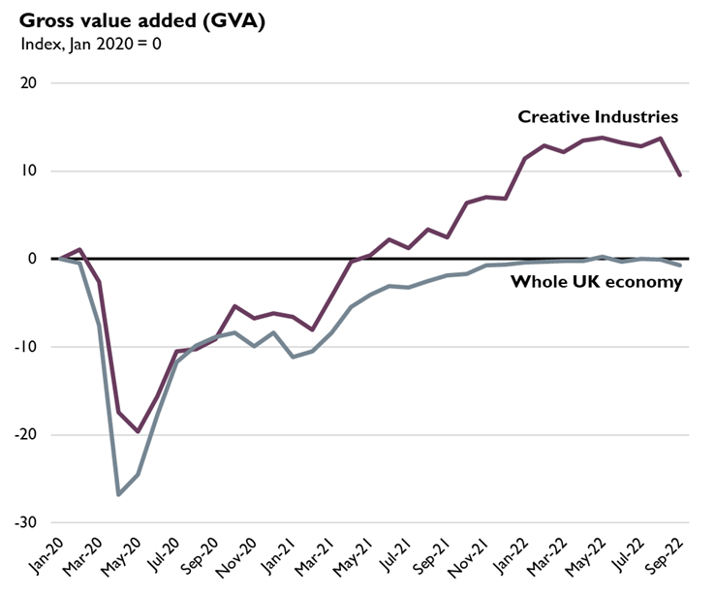
CG is central to the creative industries
https://lordslibrary.parliament.uk/arts-and-creative-industries-the-case-for-a-strategy/

Slide 10

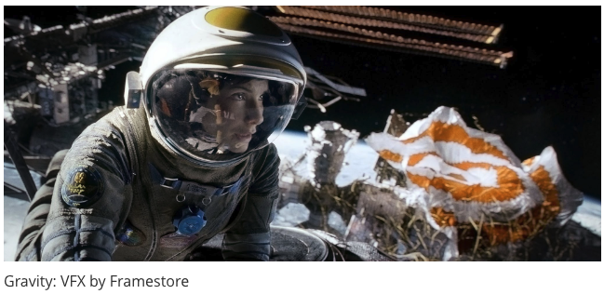
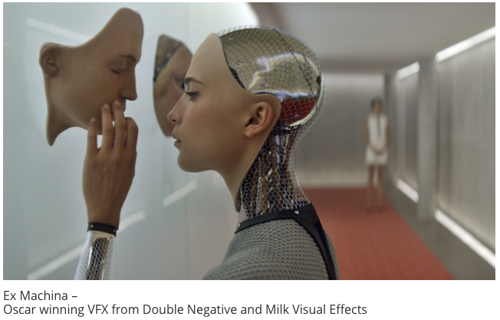


It’s all happening here in the UK!

Slide 11

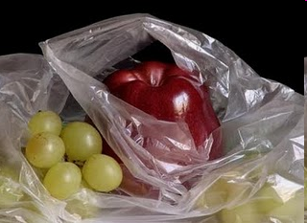

Simulating photorealistic pictures?
photograph
manually painted
computer generated
Colourbox.com
Pedro Campos

Slide 12
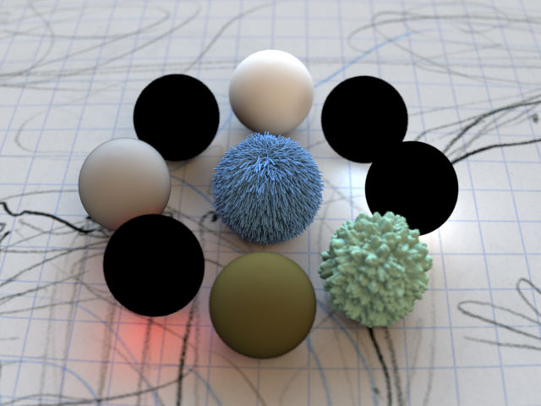
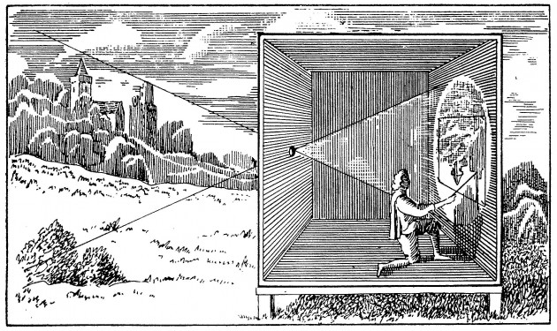
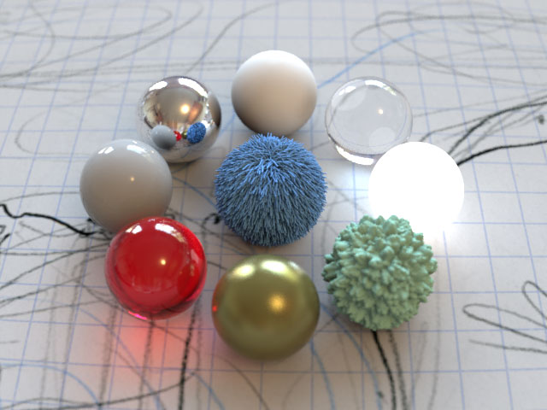
Physically based simulation, at its core!
Projective geometry
Energy
(light transport)

Slide 13
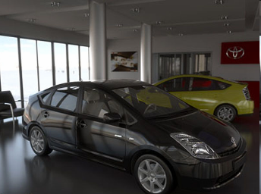
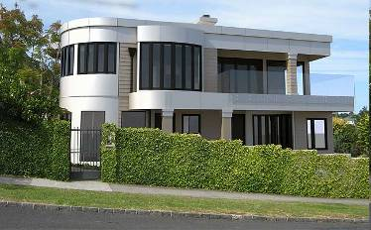
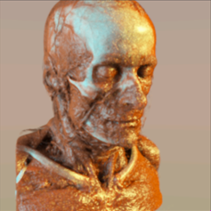
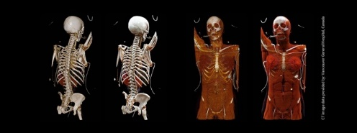
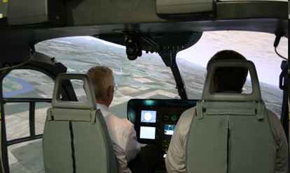

Advertising
Engineering
Medicine
Defense
Entertainment

Slide 14








Simulate the physics of light
lenses
defocus
exposure time
light, media
materials

Slide 15
About the course …
coursework only (no exam)
2 coursework assignments: C1, C2
Final mark = C1 + C2
class split into 3 groups (for tutorials)
Tutorials provide guidance towards CW
GPT!! Get your free account today…

Slide 16

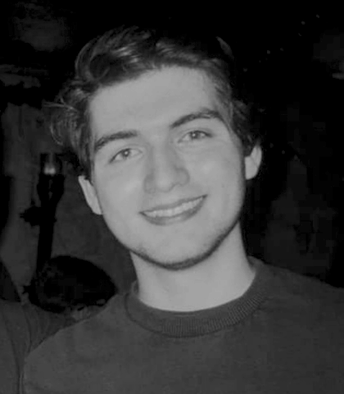
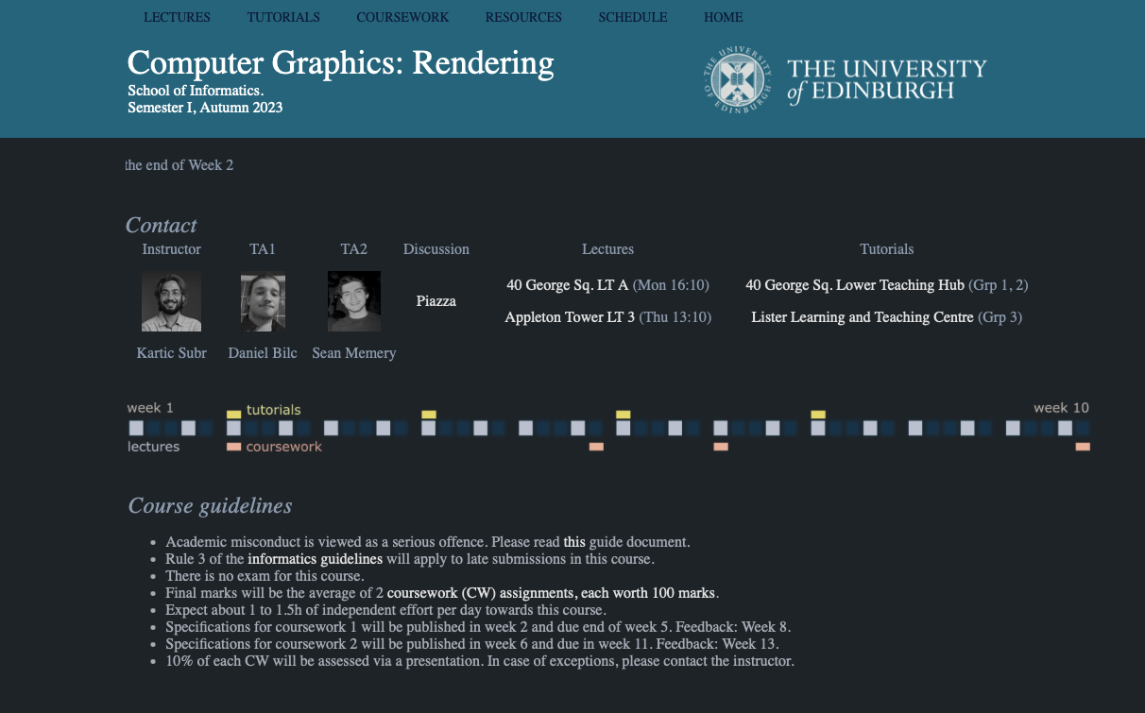
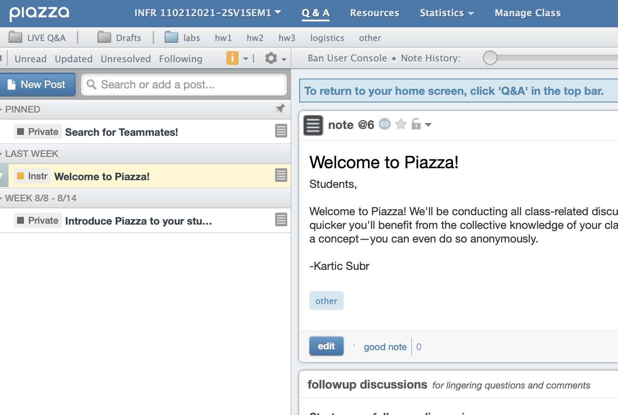
Logistics
Daniel
Sean
CW1: Daniel Bilc
CW2: Sean Memery
?
Course website
piazza
https://ksubr.github.io/CGR2023/

Slide 17
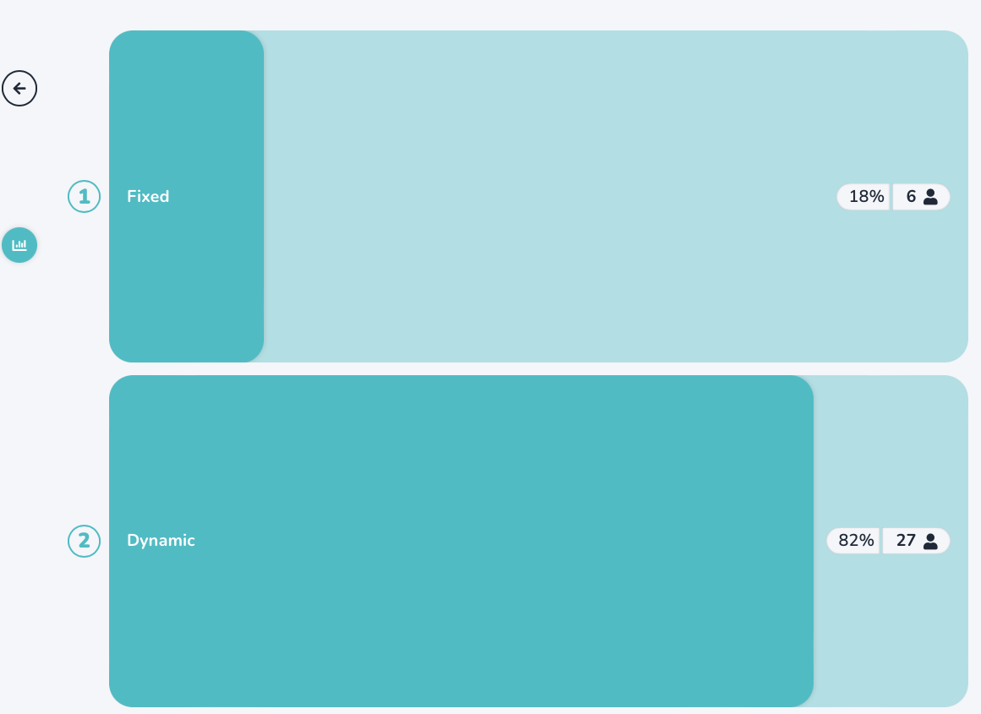
Logistics
Daniel
Sean
CW1: Daniel Bilc
CW2: Sean Memery
?
Course website
piazza
https://ksubr.github.io/CGR2023/

Slide 18
CGR
Theory (28h)
16h lectures
12h reading
Practice (70h)
4h tutorials
6h creative thinking
30h CW1
30h CW2

Slide 19
Main feedback/criticism previous offering
CW1 worth too much credit
CW2: basic ray tracing took too long
CW2 timing not ideal (other coursework)
More detailed lecture on coordinate transforms

Slide 20
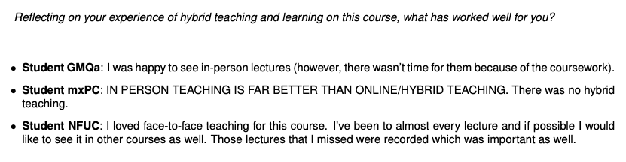
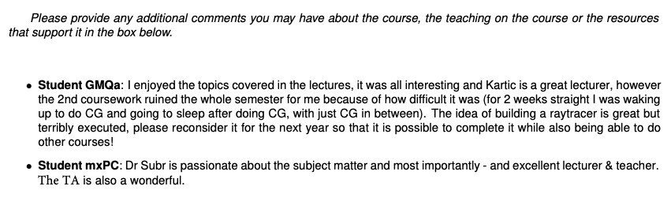
Comments …

Slide 21
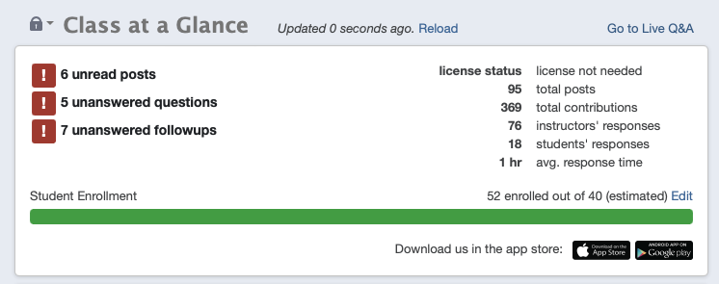
Top tips
Try to attend as many lectures as possible in-person
Work regularly – not just before deadlines
Use your opportunity to interact with the instructor
previous offering

